Slide 1
security at the transport layer SSL and TLS

Slide 2
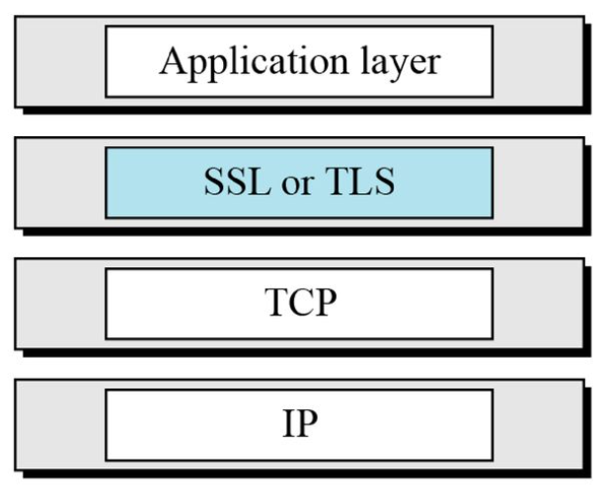
Location of SSL and TLS in the internet model

Slide 3
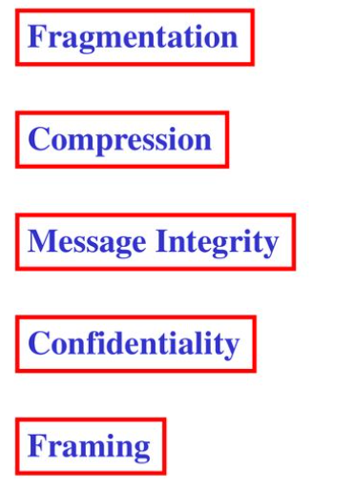
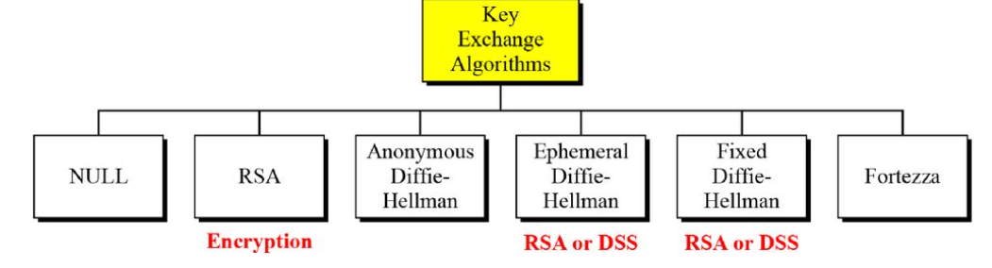
SSL Architecture
SSL is designed to provide security and compression services to data generated from the application layer.originally developed by Netscape.version 3 designed with public input. uses TCP to provide a reliable end-to-end service
Services Key Exchange Algorithms

Slide 4
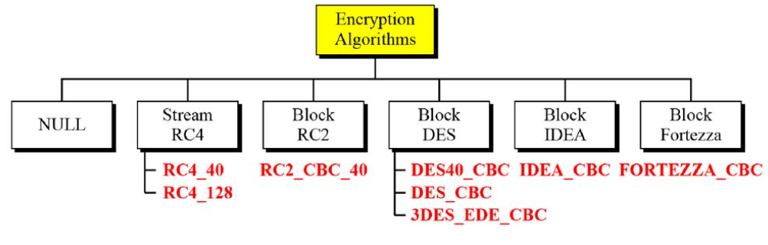
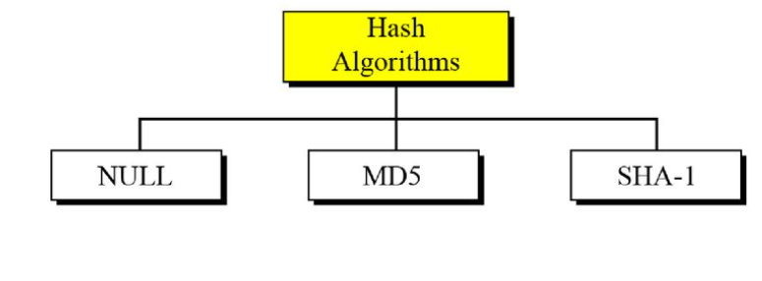
Encryption and decryption Algorithms
Hash Algorithms

Slide 5

Cipher suite
The combination of key exchange, hash, and encryption algorithms defines a cipher suite for each SSL session.
Example:
Compression Algorithms
Compression is optional in SSLv3. No specific compression algorithm is defined for SSLv3. Therefore, the default compression method is NULL.

Slide 6
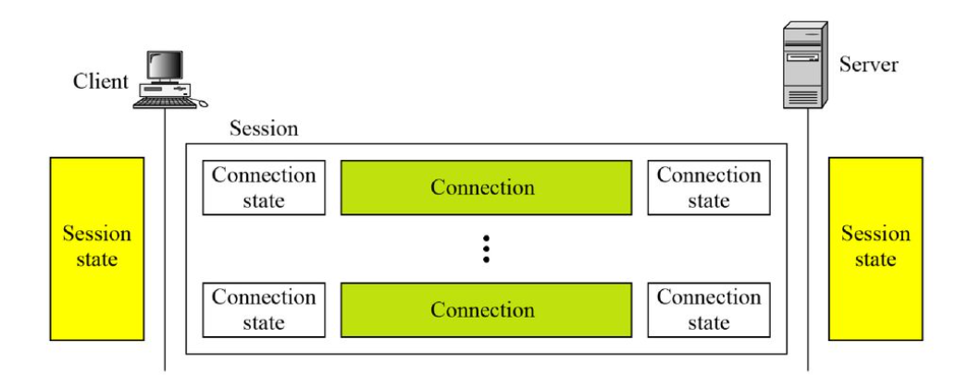
Sessions and Connections
In a session, one party has the role of a client and the other the role of a server; in a connection, both parties have equal roles, they are peers.

Slide 7
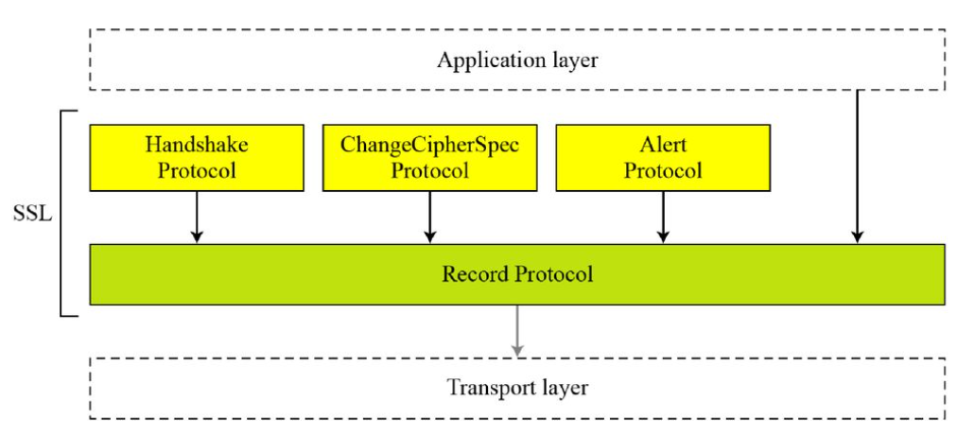
Four Protocols of SSL

Slide 8
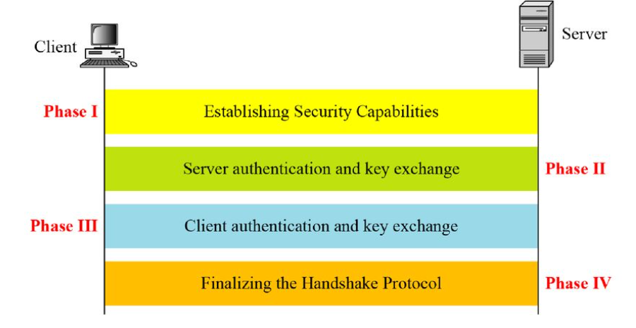
Handshake Protocol

Slide 9
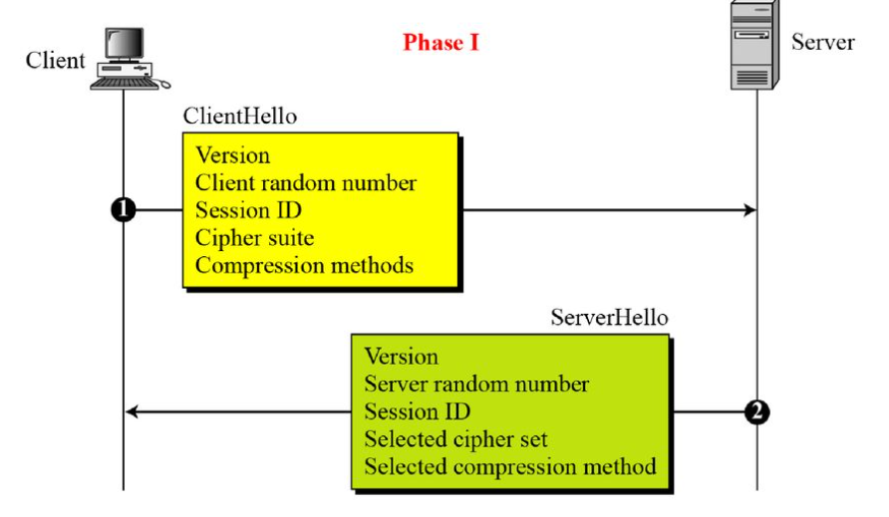
Phase I of Handshake Protocol
After Phase I, the client and server know the following:
❏ The version of SSL
❏ The algorithms for
key exchange, message
authentication, and encryption
❏ The compression
method
❏ The two random
numbers for key
generation

Slide 10
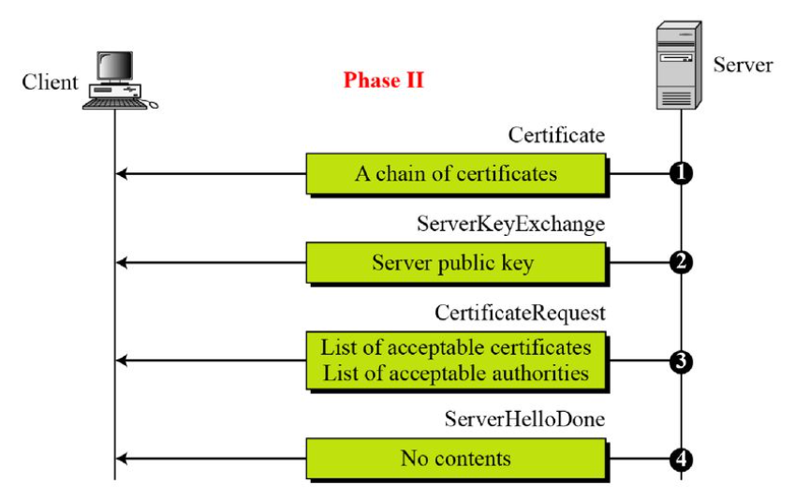
Phase II of Handshake Protocol
After Phase II,
❏ The server is authenticated
to the client.
❏ The client knows the public
key of the server if required.

Slide 11
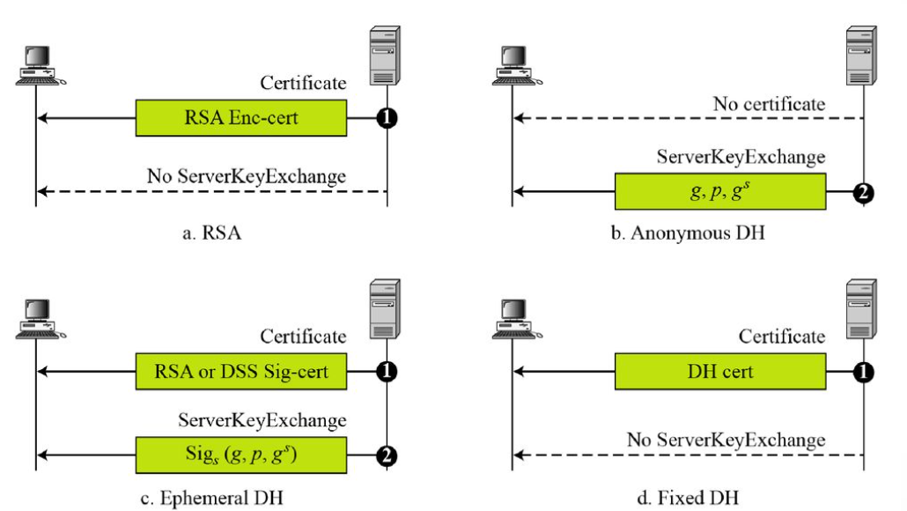
Four cases in Phase II

Slide 12
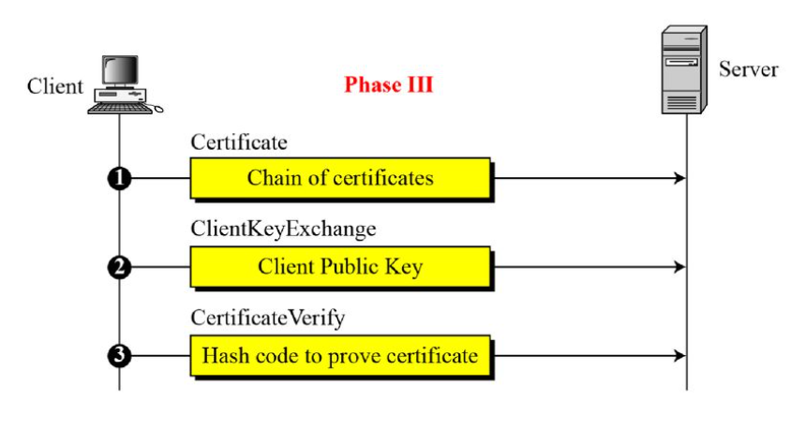
Phase III of Handshake Protocol
After Phase III,
❏ The client is authenticated for the server.
❏ Both the client and the server know the pre-master secret.

Slide 13
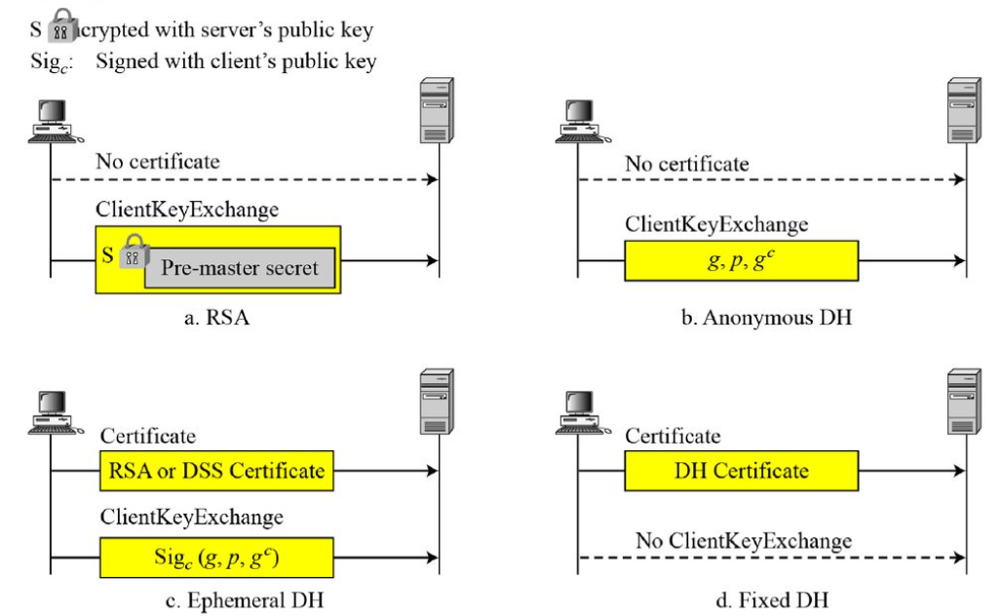
Four cases in Phase III

Slide 14
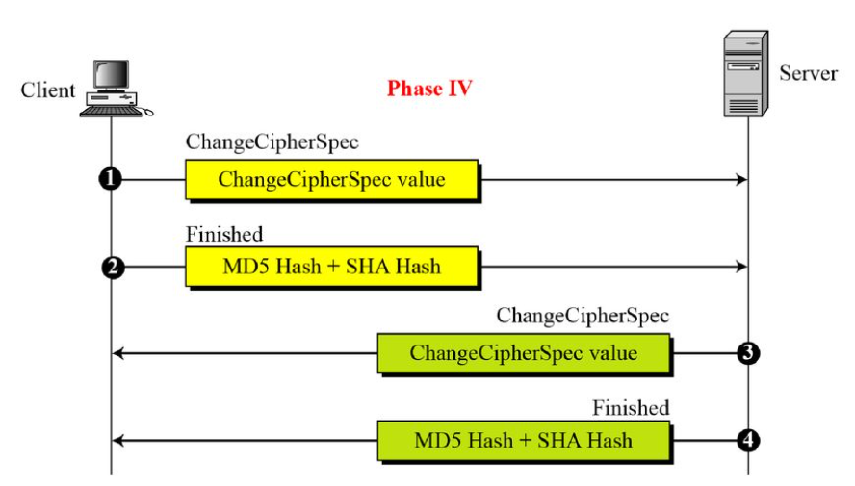
Phase IV of Handshake Protocol
After Phase IV, the client and server are ready to exchange data.

Slide 15
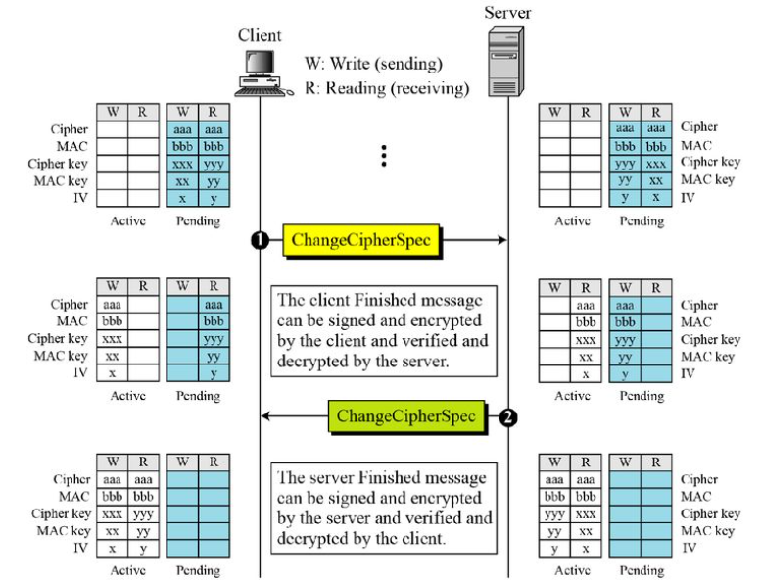
ChangeCipherSpec Protocol
Movement of parameters from pending state to active state

Slide 16
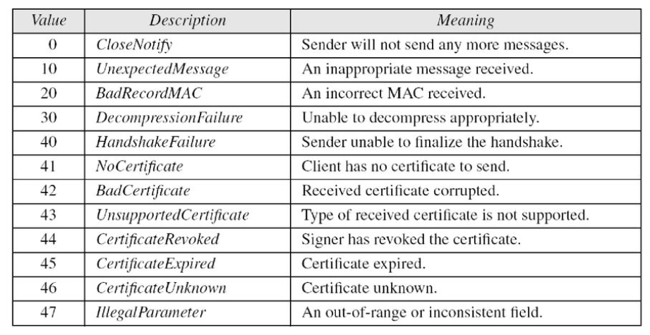
Alert Protocol

Slide 17
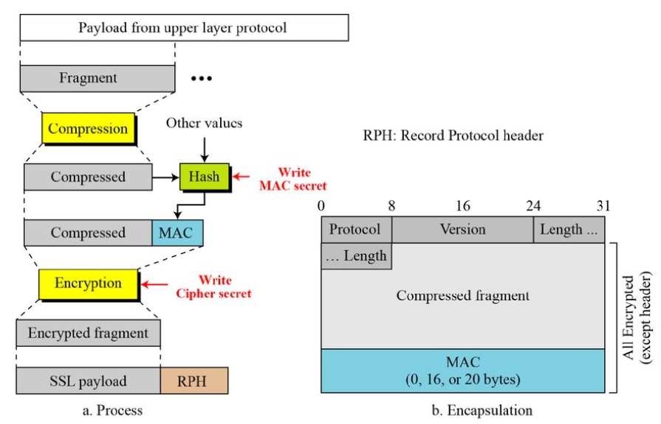
Record Protocol

Slide 18
Transport Layer Security (TLS)
The Transport Layer Security (TLS) protocol is the IETF standard version of the SSL protocol. The two are very similar, with slight differences.
– in record format version number
– uses HMAC for MAC
– a pseudo-random function expands secrets
– has additional alert codes
– some changes in supported ciphers
– changes in certificate negotiations
– changes in use of padding
Version
The first difference is the version number (major and minor). The current version of SSL is 3.0; the current version of TLS is 1.0. In other words, SSLv3.0 is compatible with TLSv1.0.
Cipher Suite
Another minor difference between SSL and TLS is the lack of support for the Fortezza method. TLS does not support Fortezza for key exchange or for encryption/decryption. Table 17.6 shows the cipher suite list for TLS (without export entries).
Alert Protocol
TLS supports all of the alerts defined in SSL except for No Certificate. TLS also adds some new ones to the list. Table 17.7 shows the full list of alerts supported by TLS.

Slide 19
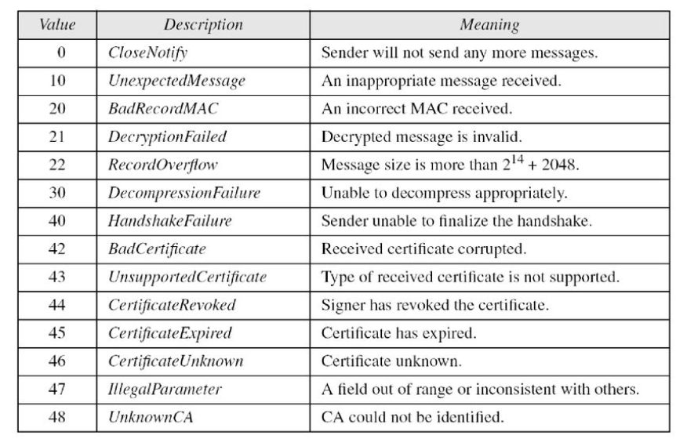

Slide 20
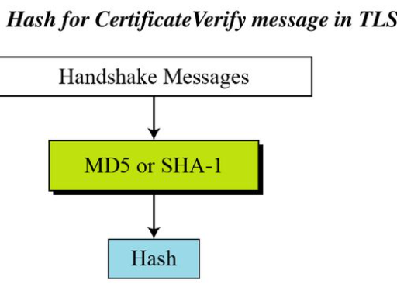
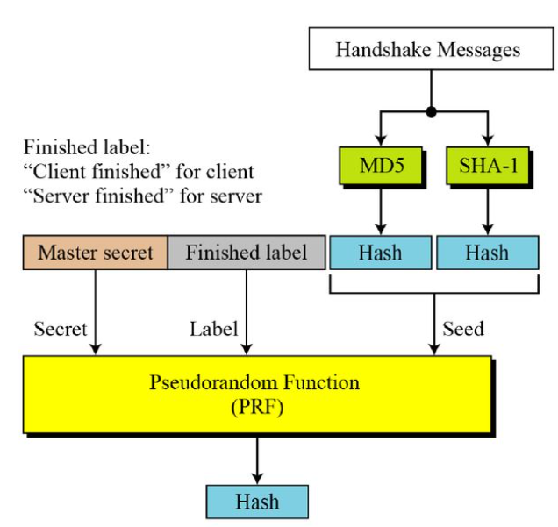
Handshake Protocol
Hash for finished messages in TLS

Slide 21
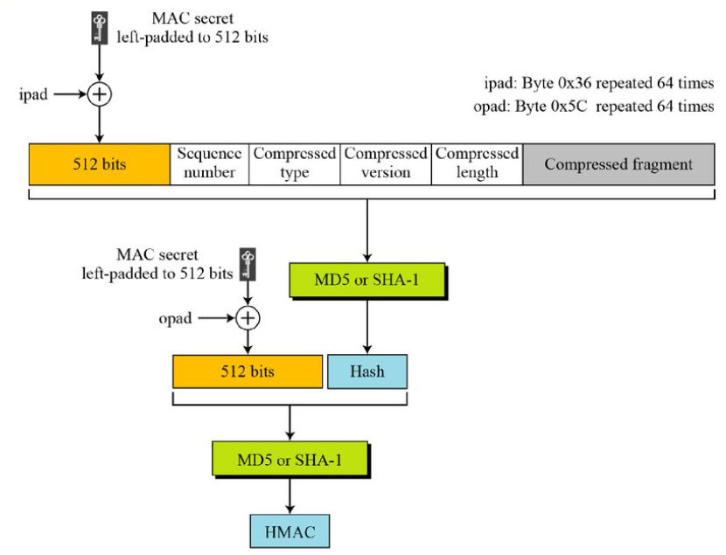
Record Protocol
HMAC for TLS

Slide 22
security at the Network Layer IPSec

Slide 23
Features of IPsec
IPsec is not designed to work only with TCP as a transport protocol. It works with UDP as well as any other protocol above IP such as ICMP, OSPF etc.
IPsec protects the entire packet presented to IP layer including higher layer headers.
Since higher layer headers are hidden which carry port number, traffic analysis is more difficult.
IPsec works from one network entity to another network entity, not from application process to application process. Hence, security can be adopted without requiring changes to individual user computers/applications.
Tough widely used to provide secure communication between network entities, IPsec can provide host-to-host security as well.
The most common use of IPsec is to provide a Virtual Private Network (VPN), either between two locations (gateway-to-gateway) or between a remote user and an enterprise network (host-to-gateway).

Slide 24
Network layer security controls have been used frequently for securing communications, particularly over shared networks such as the Internet because they can provide protection for many applications at once without modifying them.
Need gave rise to develop a security solution at the IP layer so that all higher-layer protocols could take advantage of it. In 1992, the Internet Engineering Task Force (IETF) began to define a standard ‘IPsec’.
IPSec operates in one of two different modes: transport mode or tunnel mode.
In transport mode, IPSec protects what is delivered from the transport layer to the network layer.
IPSec in transport mode does not protect the IP header; it only protects the information coming from the transport layer.
In tunnel mode, IPSec protects the entire IP packet. It takes an IP packet, including the header, applies IPSec security methods to the entire packet, and then adds a new IP header.
IPSec in tunnel mode protects the original IP header.

Slide 25
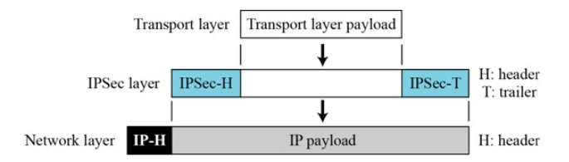
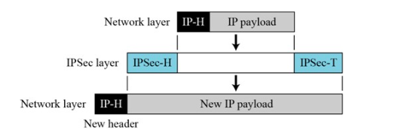
IPSec in Transport Mode
IPSec in Tunnel Mode

Slide 26
TWO SECURITY PROTOCOL
IPSec defines two protocols—the Authentication Header (AH) Protocol and the Encapsulating Security Payload (ESP) Protocol to provide authentication and/or encryption for packets at the IP level.
Authentication Header (AH)
The AH protocol provides source authentication and data integrity, but not privacy.
Encapsulating Security Payload (ESP)
ESP provides source authentication, data integrity, and privacy.

Slide 27
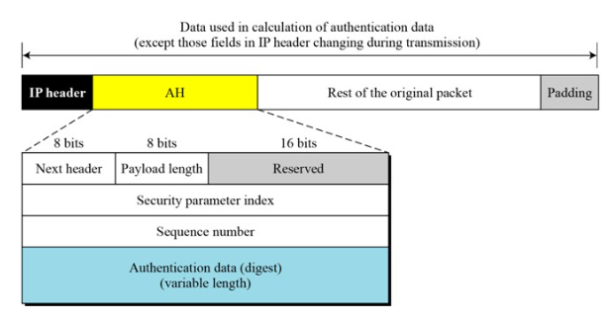
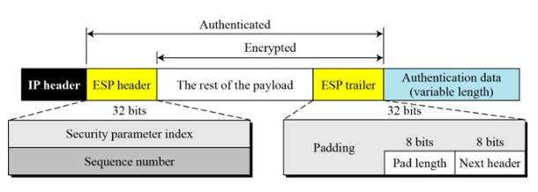
B. Encapsulating Security Payload
A. Authentication Header

Slide 28
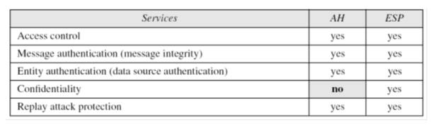
IPSec supports both IPv4 and IPv6. In IPv6, however, AH and ESP are part of the extension header.
Services provided by IPSec

Slide 29


Slide 30
Implementation of Cryptographic Techniques
The following are four cryptographic techniques used for cybersecurity worldwide.
3DES
AES
RSA
Twofish
Twofish is based on the earlier version of the block cipher called Blowfish. Essentially, it is also a symmetric block cipher, with a block size ranging from 128 to 256 bits.

Slide 31
OPENSSL
OpenSSL is a software library for applications that secure communications over computer networks against eavesdropping or need to identify the party at the other end. It is widely used by Internet servers, including the majority of HTTPS websites.
What is OpenSSL used for?
OpenSSL is an open-source command line tool that is commonly used to generate private keys, create certificate signing request ( CSRs), install your SSL/TLS certificate, and identify certificate information.
OpenSSL is licensed under an Apache-style license, which basically means that you are free to get and use it for commercial and non-commercial purposes subject to some simple license conditions.
openssl version -a

Slide 32
Hash Value of Calculations
Hashing involves applying a hashing algorithm to a data item, known as the hashing key, to create a hash value. Hashing algorithms take a large range of values (such as all possible strings or all possible files) and map them onto a smaller set of values (such as a 128 bit number).
Why HASH?
Fingerprint of message does not tell anything about the message. This is because there are infinite other possible equations which can produce same result.
Hashing has two main applications.
Here is a website used for the calculation of hash values.
https://www.fileformat.info/tool/hash.htm

Slide 33
MD5
MD5 algorithm was developed by Professor Ronald L. Rivest in 1991.
According to RFC 1321, “MD5 message-digest algorithm takes as input a message of arbitrary length and produces as output a 128-bit "fingerprint" or "message digest" of the input …
The MD5 algorithm is intended for digital signature applications, where a large file must be "compressed" in a secure manner before being encrypted with a private (secret) key under a public-key cryptosystem such as RSA.”
It performs very fast on 32-bit machine.
MD5 is being used heavily from large corporations, such as IBM, Cisco Systems, to individual programmers.
MD5 is considered one of the most efficient algorithms currently available.

Slide 34
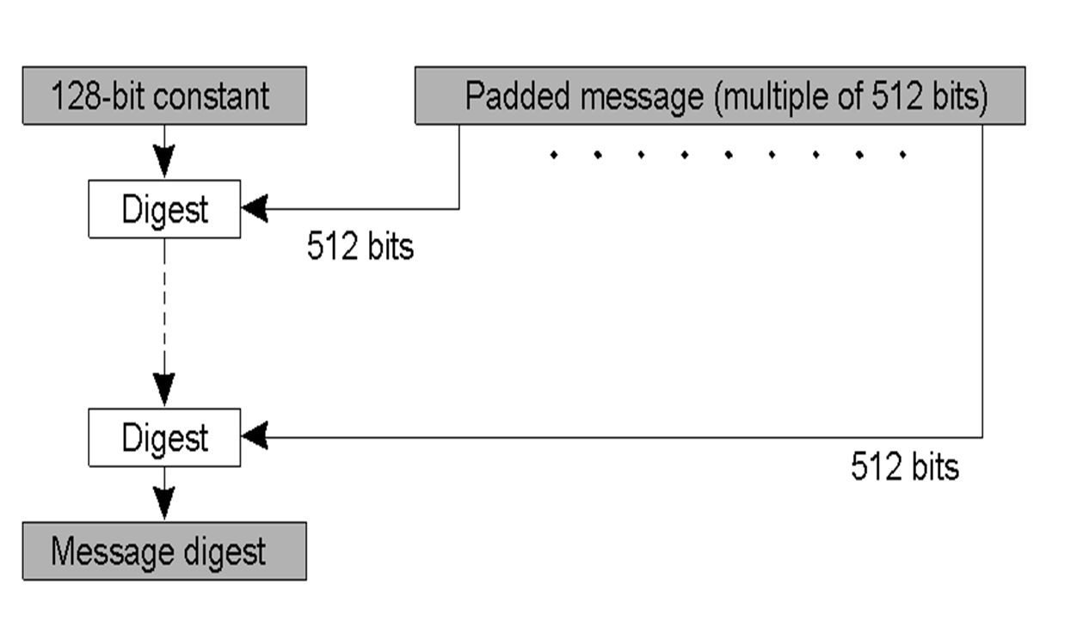
MD5 Algorithm Structure

Slide 35
Steps
Append padding bits
The input message is "padded" (extended)
Padding is performed as follows: a single "1" bit is appended to the message, and then "0" bits are appended so that the length in bits of the padded message becomes congruent
Append length
A 64-bit representation of the length of the message is appended to the result of step1.
The input message will have a length that is an exact multiple of 16 (32-bit) words.
Initialize MD buffer
A four-word buffer (A, B, C, D) is used to compute the message digest. Each of A, B, C, D is a 32-bit register.
Process message in 16-word blocks
Four functions will be defined such that each function takes an input of three 32-bit words and produces a 32-bit word output.

Slide 36
SHA 512
SHA-512 is a hashing algorithm that performs a hashing function on some data given to it.
Hashing algorithms are used in many things such as internet security, digital certificates and even blockchains.
Since hashing algorithms play such a vital role in digital security and cryptography, this is an easy-to-understand walkthrough, with some basic and simple maths along with some diagrams, for a hashing algorithm called SHA-512.
It’s part of a group of hashing algorithms called SHA-2 which includes SHA-256 as well which is used in the bitcoin blockchain for hashing.

Slide 37
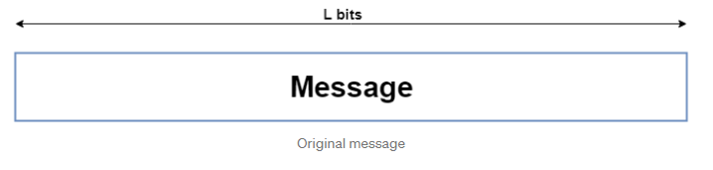
Hashing Algorithm — SHA-512
So, SHA-512 does its work in a few stages. These stages go as follows:
Input formatting
Hash buffer initialization
Message Processing
Output
Input Formatting: SHA-512 can’t actually hash a message input of any size, i.e. it has an input size limit. This limit is imposed by its very structure as you may see further on. The entire formatted message has basically three parts: the original message, padding bits, size of original message. And this should all have a combined size of a whole multiple of 1024 bits. This is because the formatted message will be processed as blocks of 1024 bits each, so each bock should have 1024 bits to work with.

Slide 38
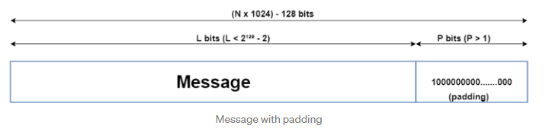
Padding bits: The input message is taken and some padding bits are appended to it in order to get it to the desired length.
Hash buffer initialization:The algorithm works in a way where it processes each block of 1024 bits from the message using the result from the previous block.
The actual value used is of little consequence, but for those interested, the values used are obtained by taking the first 64 bits of the fractional parts of the square roots of the first 8 prime numbers (2,3,5,7,11,13,17,19). These values are called the Initial Vectors (IV).

Slide 39
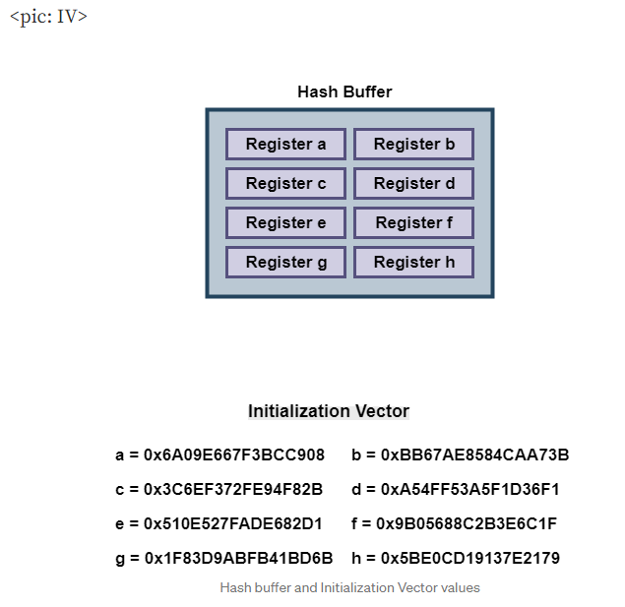

Slide 40
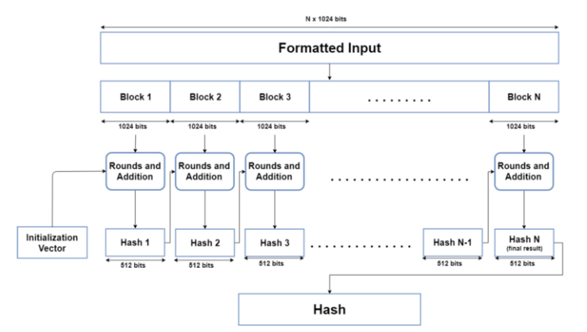
Message Processing:
Message processing is done upon the formatted input by taking one block of 1024 bits at a time.
The actual processing takes place by using two things: The 1024 bit block, and the result from the previous processing.
This part of the SHA-512 algorithm consists of several ‘Rounds’ and an addition operation.

Slide 41
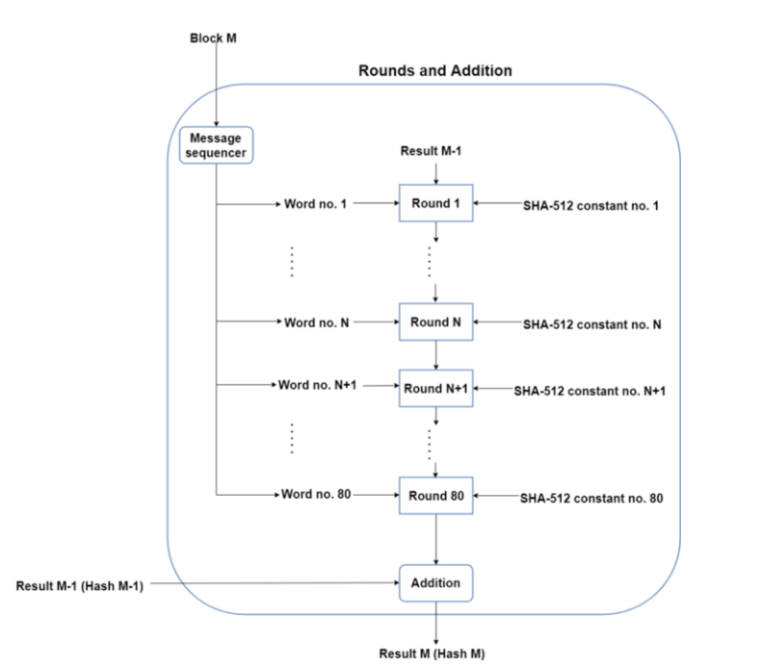
Rounds

Slide 42
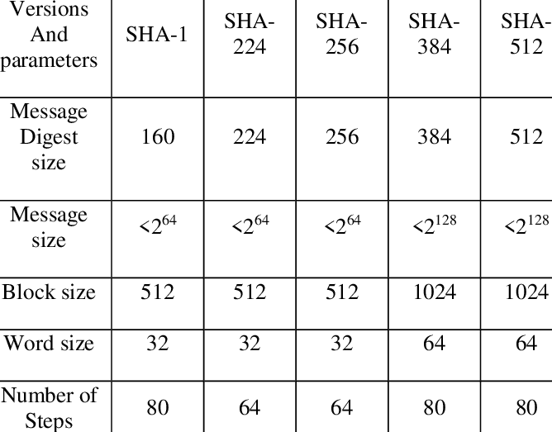
Difference between different SHA versions

Slide 43
Steganography
It is a method that attempts to hide the existence of a message or communication.
The word “steganography” comes from the two Greek words: steganos meaning “covered” and graphein meaning “to write” that means “concealed writing.”
Steganalysis
Steganalysis is the art and science of detecting messages that are hidden in images,
audio/video files using steganography.
Automated tools are used to detect such steganography data/information hidden in the image and audio and/or video files.

Slide 44
Tools
Steghide is a steganography program that hides data in various kinds of image and audio files, only supports these file formats: JPEG,WAV, BMP and AU.
Foremost is a program that recovers files based on their headers, footers and internal data structures, found it useful when dealing with png images.
Strings is a linux tool that displays printable strings in a file. That simple tool can be very helpful when solving stego challenges.
Binwalk is a tool for searching binary files like images and audio files for embedded files and data.
Zsteg is a tool that can detect hidden data in png and bmp files.
WavSteg is a python3 tool that can hide data and files in way files and can also extract data from wav files.
Sonic visualizer is a tool for viewing and analyzing the contents of audio files, however it can be helpful when dealing with audio steganography.

